Slide 1
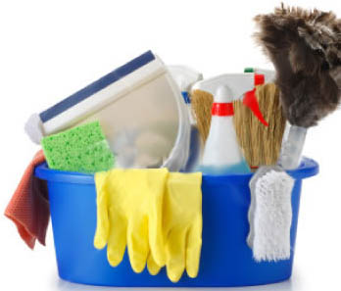
Time For A Housecleaning

Slide 2

Baptism: The Extreme Makeover
Baptism: Dying to Live
  Often, misunderstandings prevent makeover
  It is how I am crucified with Christ
By no means! How can we who died to sin still live in it? Do you not know that all of us who have been baptized into Christ Jesus were baptized into his death? We know that our old self was crucified with him in order that the body of sin might be brought to nothing, so that we would no longer be enslaved to sin. Rom. 6:2-3/6

Slide 3
Baptism: The Extreme Makeover
Baptism clears the “junk” associated with self
And he said to all, “If anyone would come after me, let him deny himself and take up his cross daily and follow me. For whoever would save his life will lose it, but whoever loses his life for my sake will save it. – Luke 9:23-24

Slide 4
Baptism: The Extreme Makeover
Baptism clears the “junk” associated with self
And those who belong to Christ Jesus have crucified the flesh with its passions and desires. – Galatians 5:24

Slide 5
Baptism: The Extreme Makeover
Baptism clears the “junk” associated with self
  It breaks ties with the world

Slide 6

In the same way we also, when we were children, were enslaved to the elementary principles of the world. But when the fullness of time had come, God sent forth his Son, born of woman, born under the law, to redeem those who were under the law, so that we might receive adoption as sons. And because you are sons, God has sent the Spirit of his Son into our hearts, crying, “Abba! Father!” So you are no longer a slave, but a son, and if a son, then an heir through God. – Galatians 4:3-7

Slide 7
Baptism: The Extreme Makeover
Baptism clears the “junk” associated with self
  It breaks ties with the world
    This includes anything not like God

Slide 8
Baptism: The Extreme Makeover
Baptism clears the “junk” associated with self
  The “trash is taken to the curb”
Baptism, which corresponds to this, now saves you, not as a removal of dirt from the body but as an appeal to God for a good conscience, through the resurrection of Jesus Christ – I Peter 3:21

Slide 9
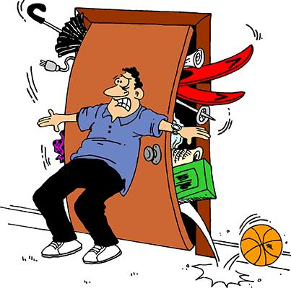
Surface Cleaning Will Not Suffice
Hypocrisy
  Ezekiel 8:7-12
  Matthew 23:23-28
  Our struggles with hypocrisy
    Unwillingness to break with self and the world

Slide 10
Surface Cleaning Will Not Suffice
Christ will not live in these conditions
  God illustrated this with Israel
  The same is true for us
Go up to a land flowing with milk and honey; but I will not go up among you, lest I consume you on the way, for you are a stiff-necked people.” – Exodus 33:3

Slide 11

Keeping It Clean
Consider the admonitions:
But now that you have come to know God, or rather to be known by God, how can you turn back again to the weak and worthless elementary principles of the world, whose slaves you want to be once more? – Galatians 4:9

Slide 12
Keeping It Clean
Consider the admonitions:
Do you not know that you are God's temple and that God's Spirit dwells in you? If anyone destroys God's temple, God will destroy him. For God's temple is holy, and you are that temple. – I Cor. 3:16-17

Slide 13
Keeping It Clean
Maintenance includes:
  Daily time with God’s word
  Constant contact with God in prayer
  Consistent times of public worship and study
  Closer relationship with brethren
  Honesty concerning temptations

Slide 14

Will Christ Find A Welcoming Place To Live?

